Slide 1

AI HealthSense: Revolutionizing Eye Care
Welcome to AI HealthSense, a pioneering project developed for the Final Year Design Project (FYDP-I) and Progressive-II at a leading Pakistani university. This presentation details the robust implementation of our eye disease prediction system, focusing on its architecture, security, and AI capabilities.

Slide 2
System Architecture Overview
Frontend: React.js + Tailwind CSS
Backend: Node.js + Express.js
A responsive, dynamic user interface for seamless interaction across patient, doctor, and admin roles, ensuring real-time validation.
Manages APIs, secure database operations, user roles, and doctor-patient interactions.
Database: MongoDB
AI Module: TensorFlow + Flask + Streamlit
NoSQL storage for users, doctors, reviews, and critical disease prediction logs.
Deep learning for eye disease prediction from images, integrated via REST API.
Authentication and security are fortified with JWT tokens, bcrypt password hashing, and OTP-based password reset for all user roles.

Slide 3
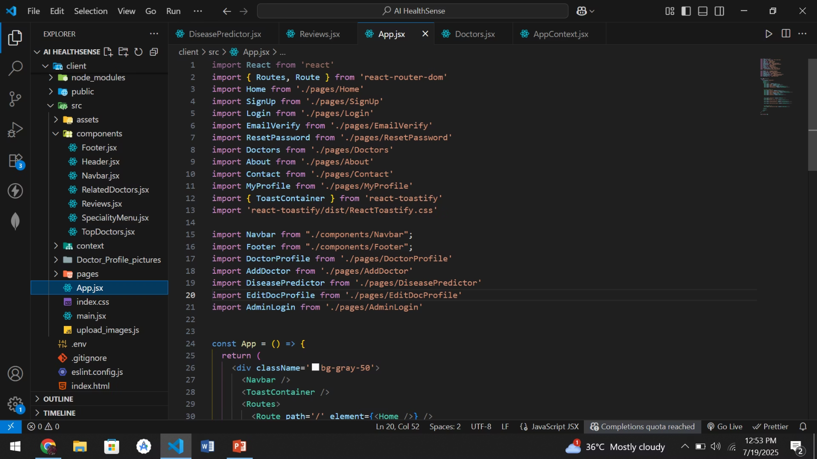
Frontend Development
Our frontend, built with React.js and styled with Tailwind CSS, ensures a responsive, user-friendly, and consistent interface across Admin, Doctor, and Patient roles.
The modular folder and component structure promotes reusability, eases debugging, and enhances scalability, vital for a growing healthcare platform.

Slide 4
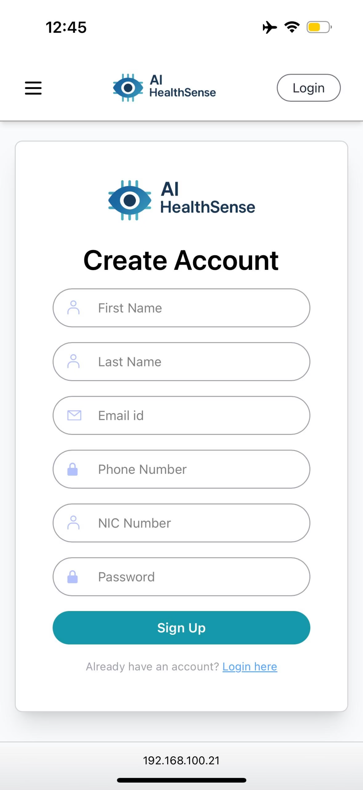
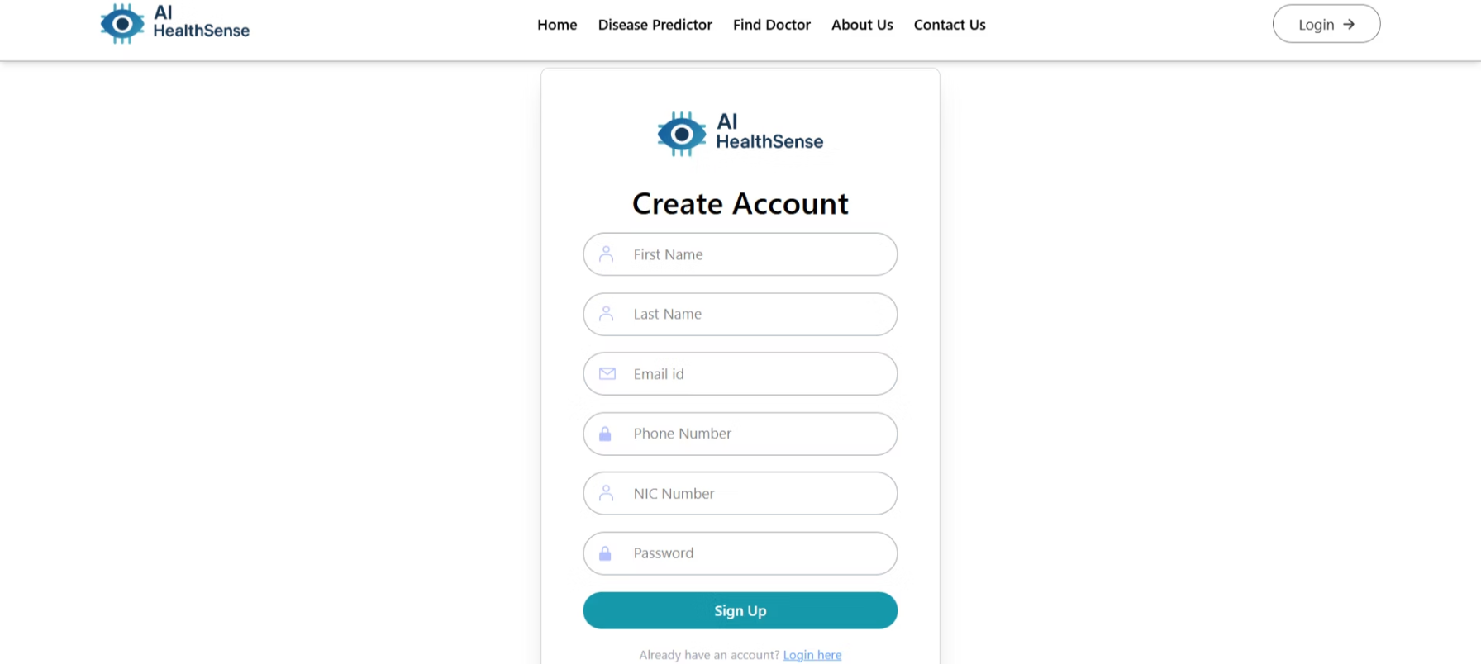
Secure Authentication Screens
Login and registration pages feature robust form validation using React Hook Form, secure password entry, and an OTP verification screen for password resets.
These are seamlessly integrated with backend APIs via Axios and secured with JWT tokens, ensuring a smooth yet protected user experience.

Slide 5
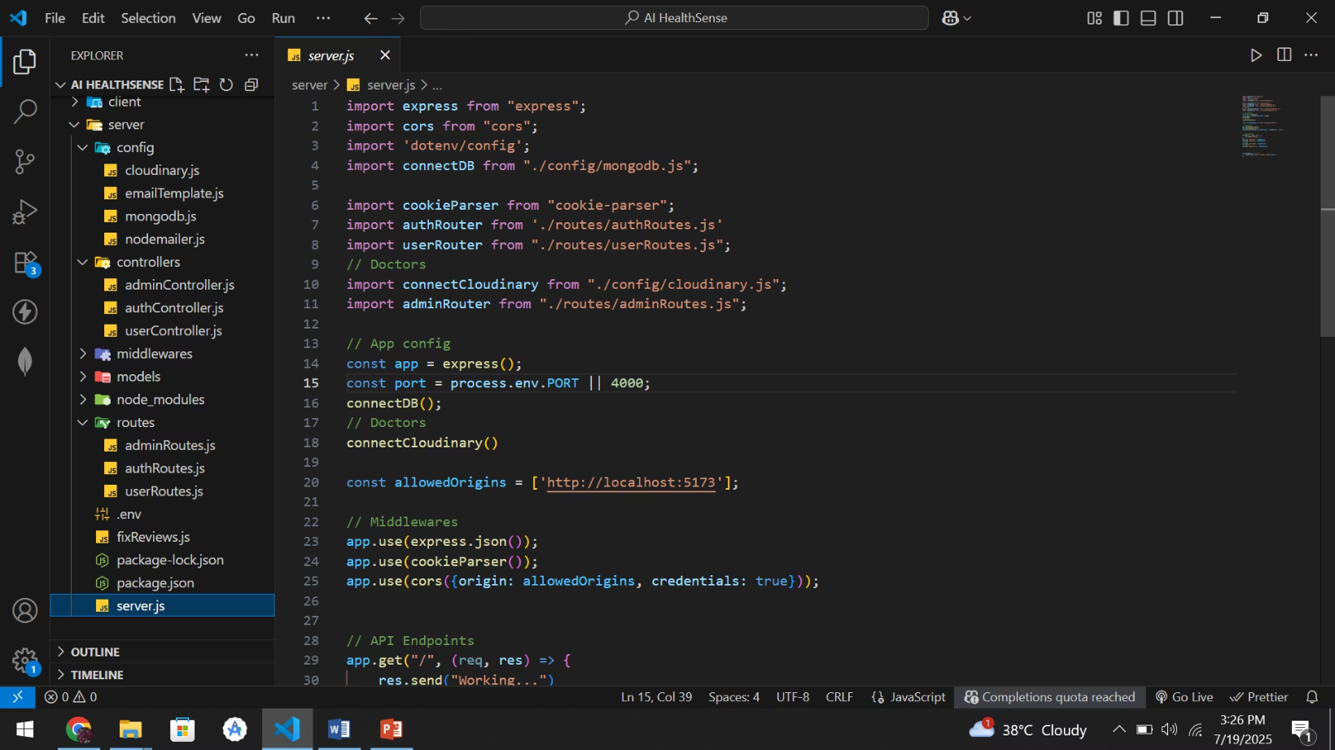
Backend Development: Node.js, Express, MongoDB
The AI HealthSense backend, built on Node.js, Express.js, and MongoDB, utilizes a RESTful architecture for efficient data management and core logic execution.
Its modular folder structure ensures separation of concerns, promoting maintainability and scalability critical for a medical application.

Slide 6


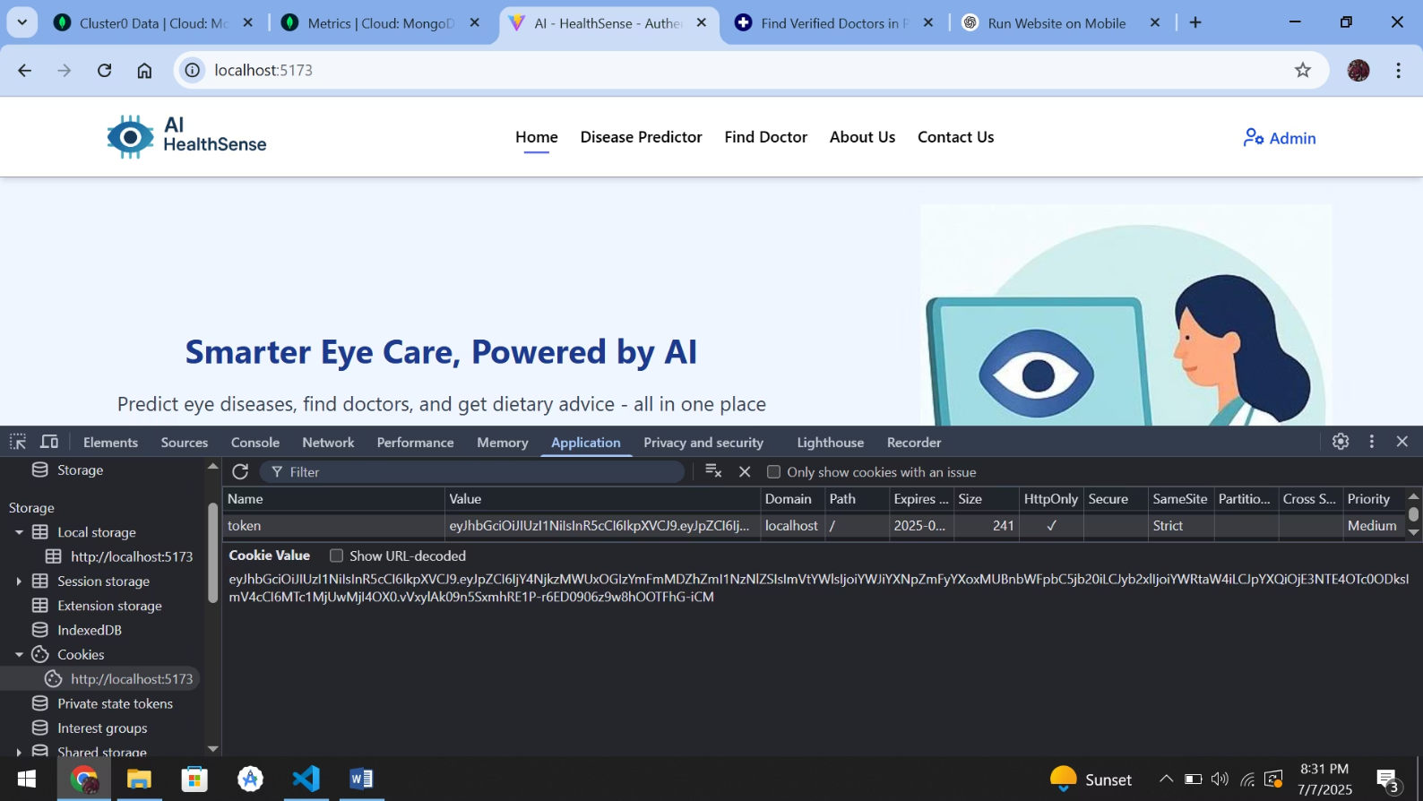
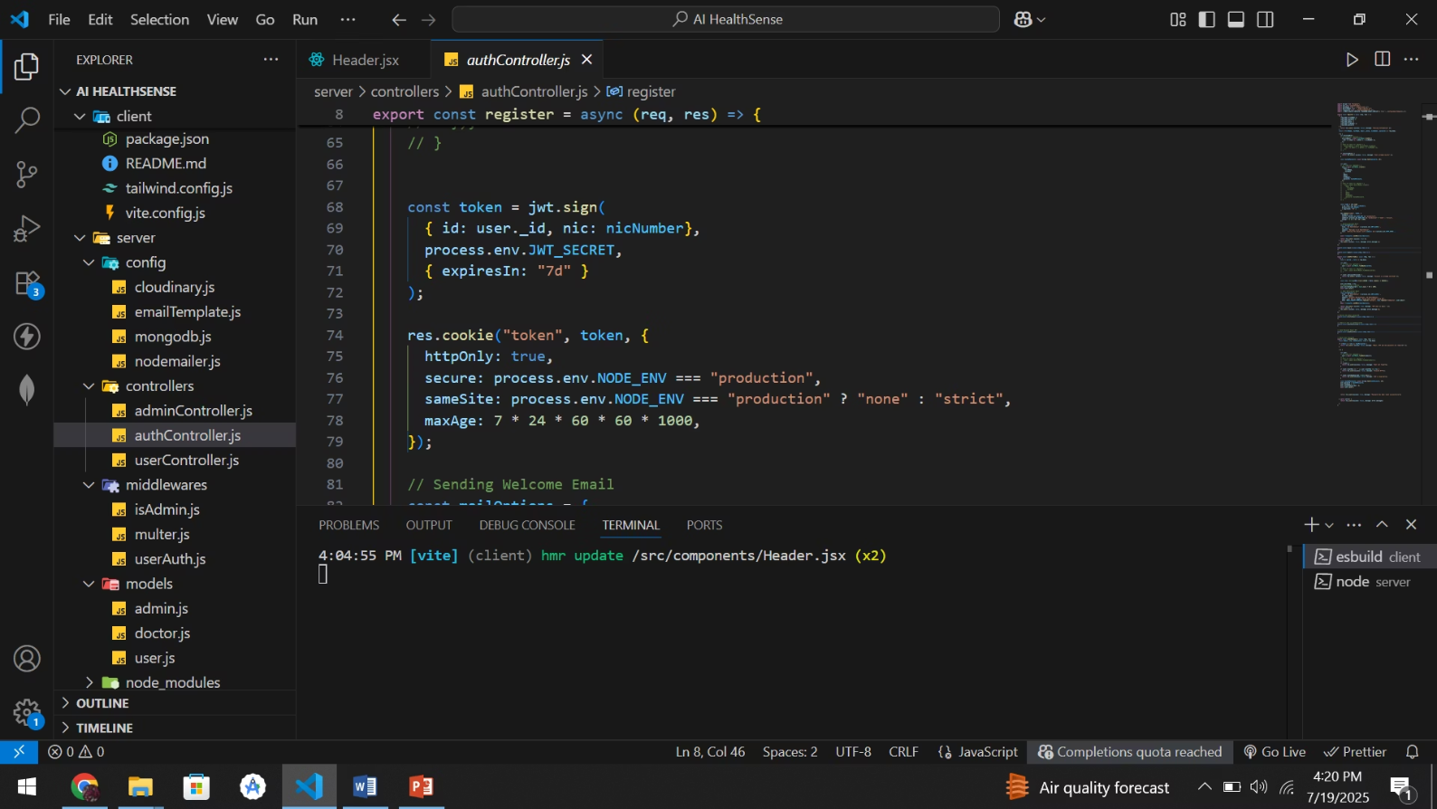
Authentication & Security
JWT Token Authentication
Cookie Storage for Access
Generates and returns JSON Web Tokens (JWT) upon login, containing userId, email, and role, expiring after 7 days for secure session management.
The JWT is securely stored in cookies, ensuring protected route access and maintaining user session integrity across the application.

Slide 7
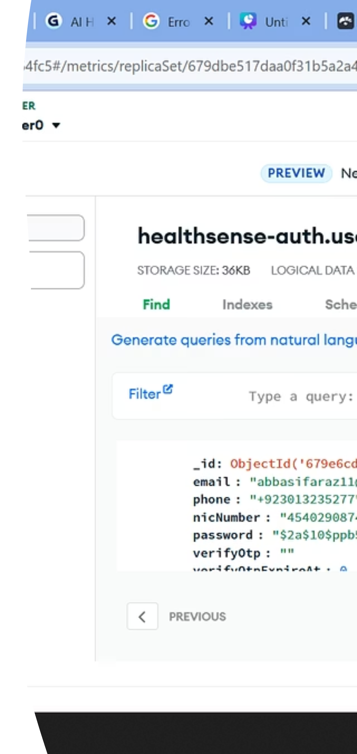
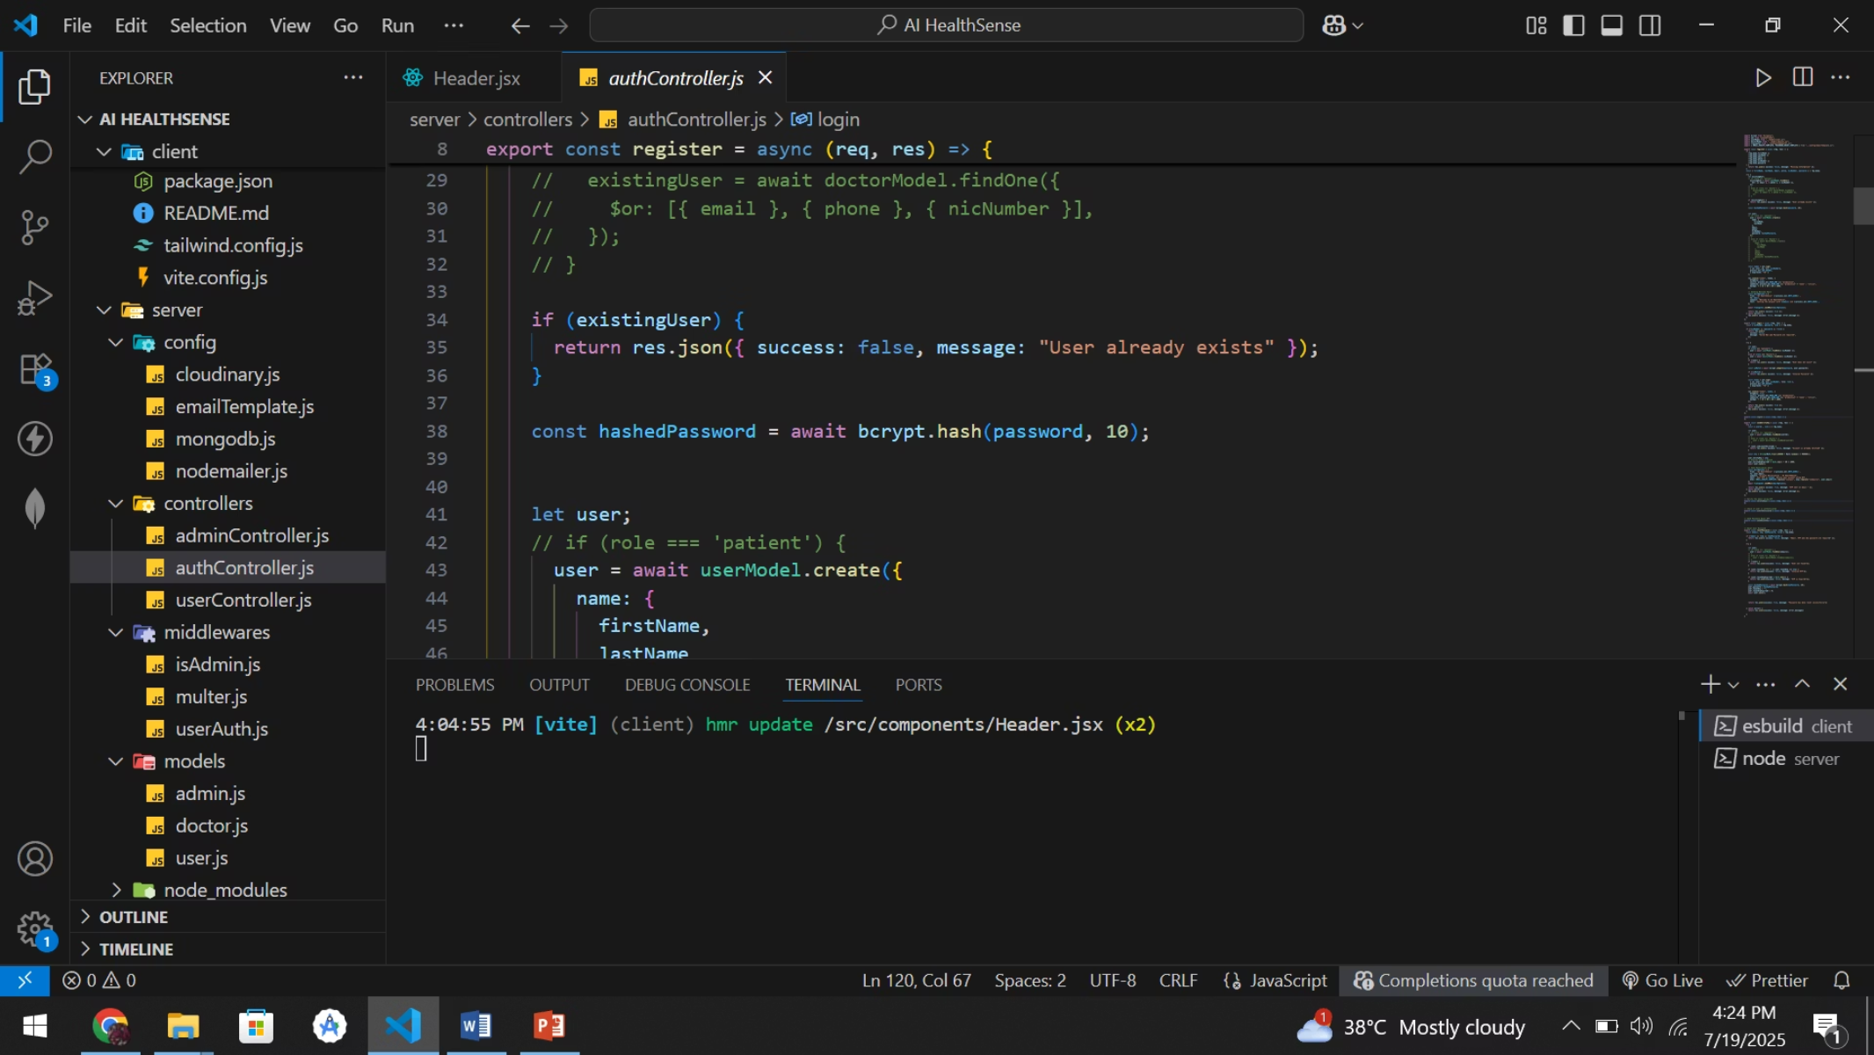
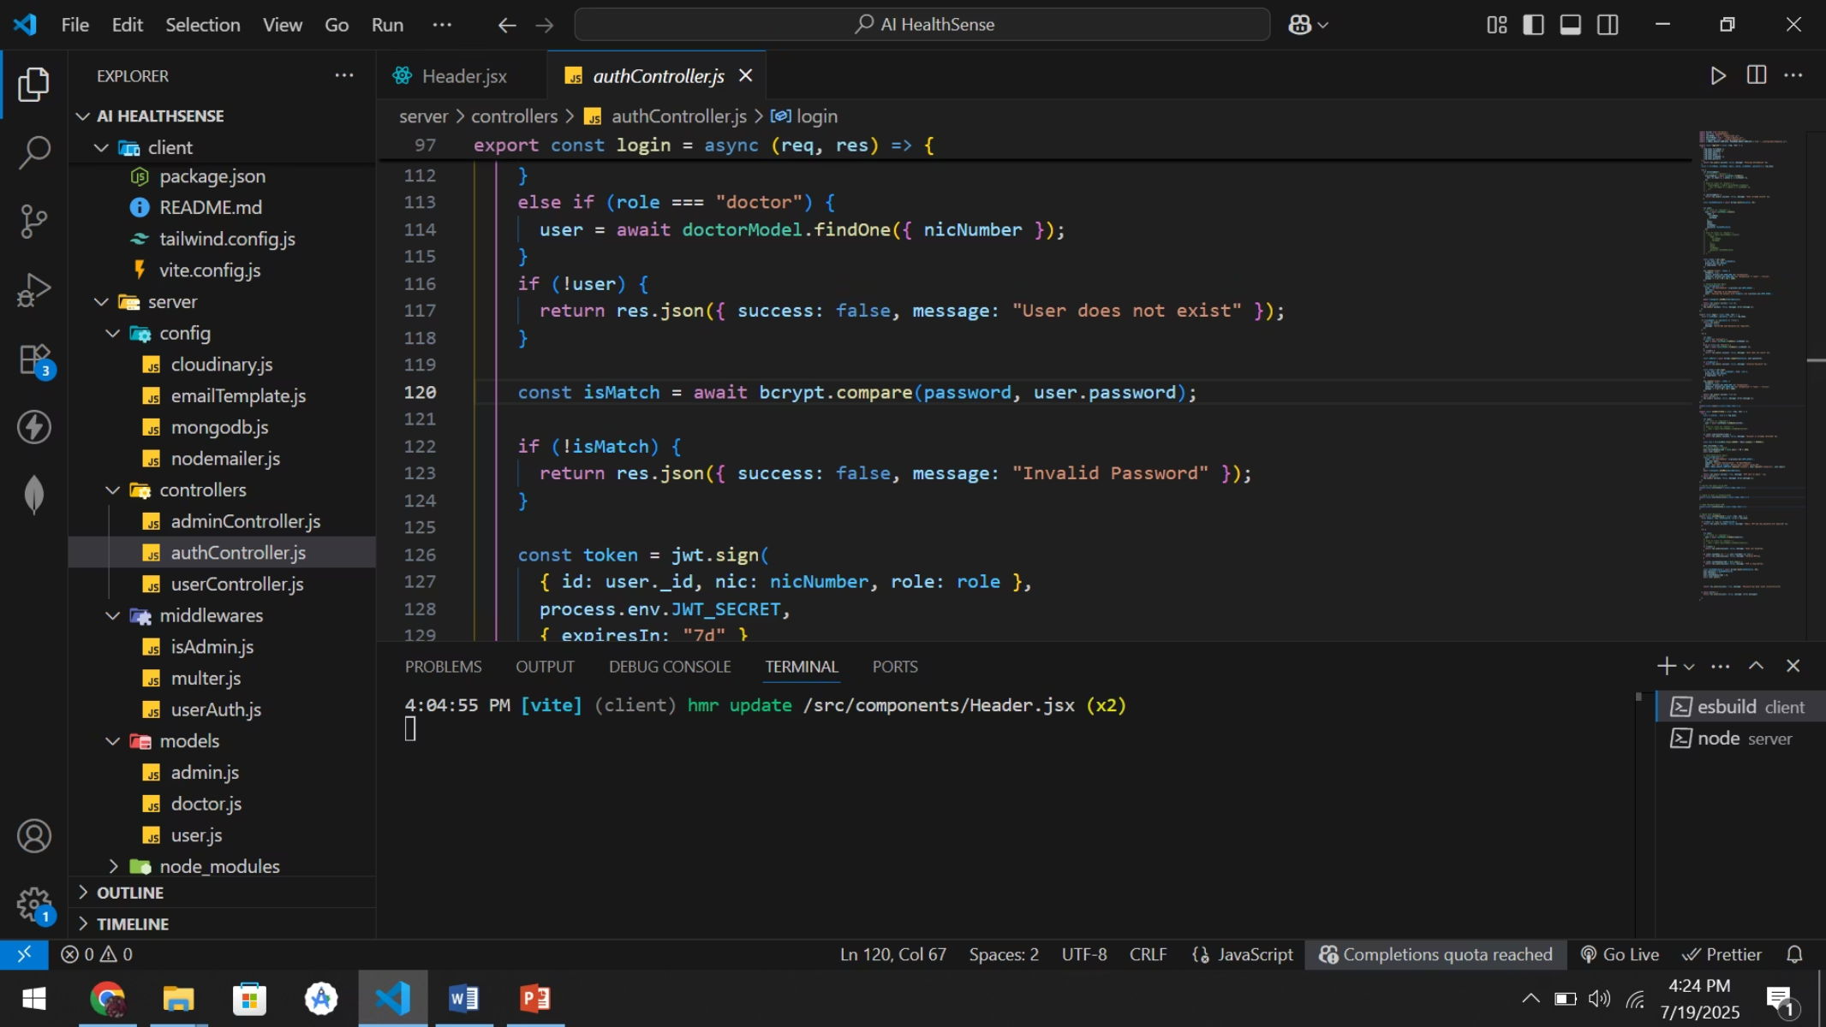
Enhanced Password Security with bcrypt
Password Hashing
All passwords are hashed using bcrypt before storage in MongoDB, rendering them unreadable even if the database is compromised.
Application Across Functions
This crucial security measure is applied during user registration, password reset procedures, and login validation, ensuring consistent protection.

Slide 8
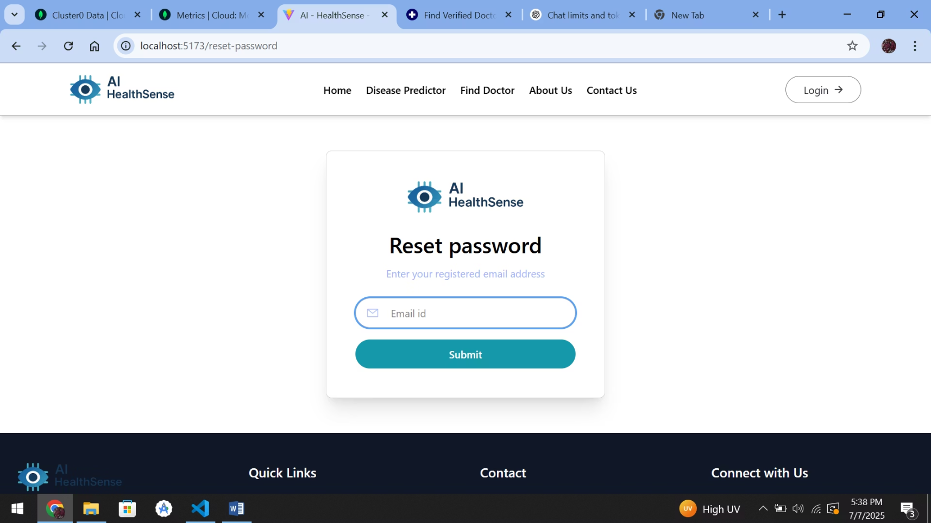
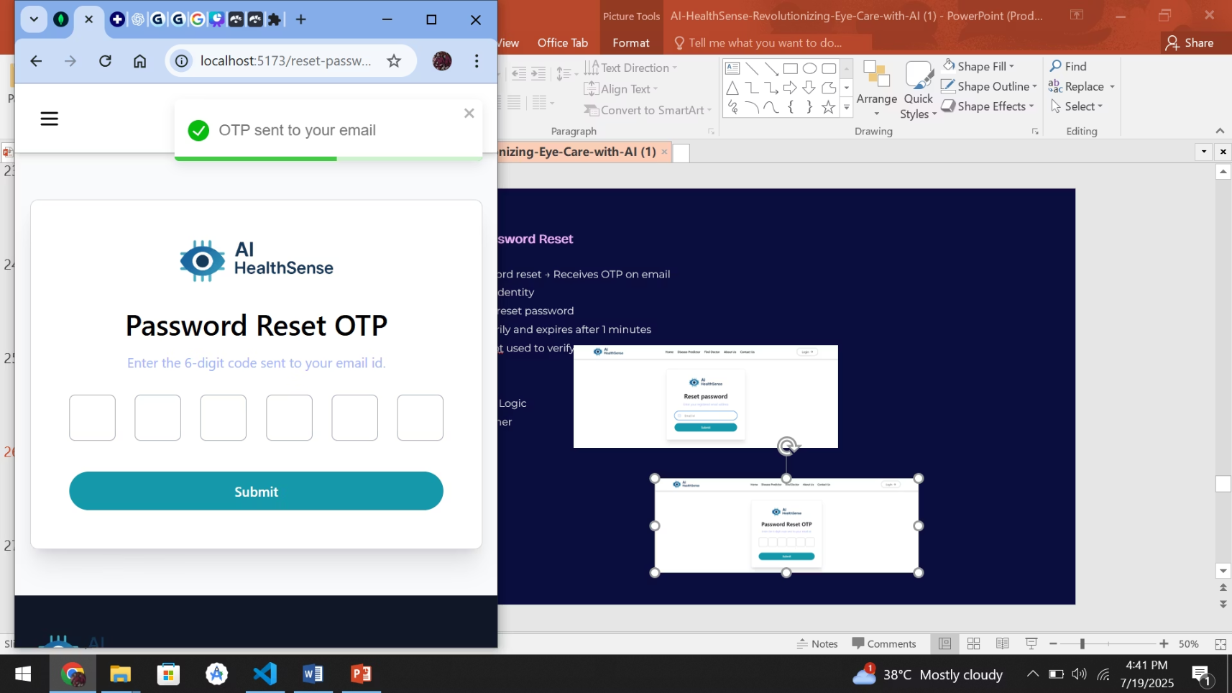
OTP-Based Password Reset
Users initiate password reset and receive a One-Time Password (OTP) via email for identity verification.
Upon correct OTP entry, users can reset their password. OTPs are temporarily stored and expire after 1 minute, secured with tokens and bcrypt.
Built using Nodemailer for email delivery, custom OTP generation logic, and precise token expiry timers.

Slide 9
AI Disease Prediction Module
Trained Eye Disease Detection Model
Detects Four Categories
Streamlit Interface
It accurately identifies four critical eye conditions: CNV, DME, Drusen, and Normal, utilizing NumPy for data preprocessing and Matplotlib for visualization.
A user-friendly Streamlit frontend allows seamless retinal X-ray uploads, instantly displaying predictions, diet suggestions, and additional information.
The module predicts eye diseases from retinal images using a TensorFlow + Keras CNN Model, trained on OCT retinal image dataset.

Slide 10
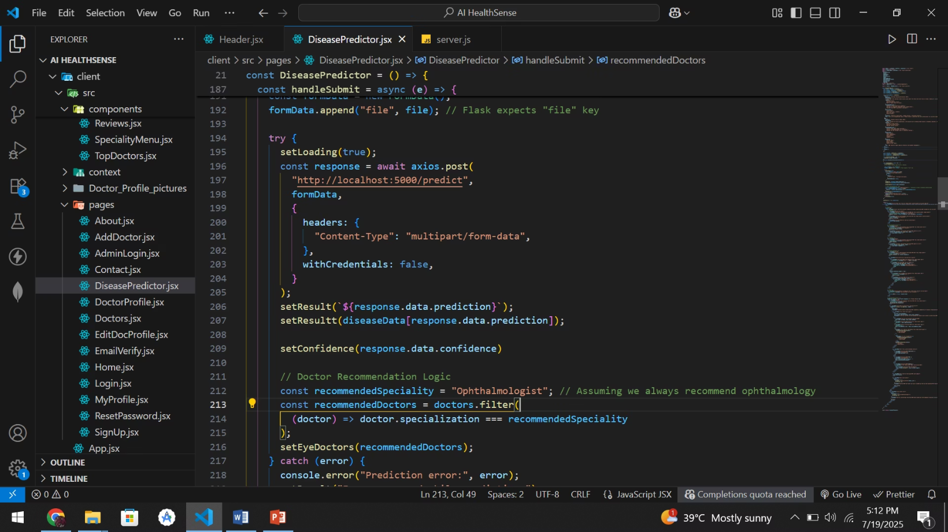
MERN Stack ↔ Flask Integration
The AI module seamlessly integrates with the MERN stack. When a user uploads a retinal image from the React frontend, Axios dispatches the image to the Flask API.
The Flask API, equipped with the TensorFlow model, processes the image and returns the prediction directly to the frontend for immediate display to the user.

